Slide 1
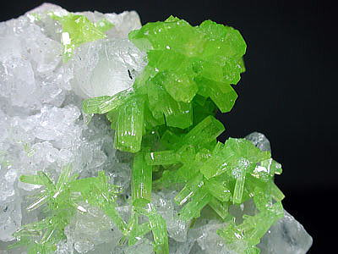
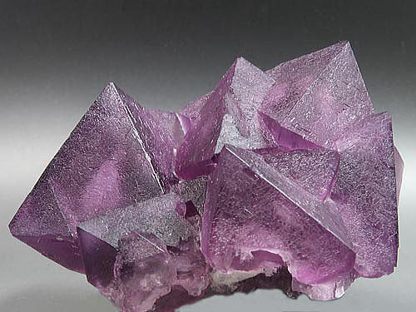
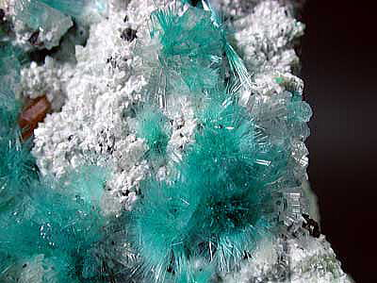
Minerals

Slide 2
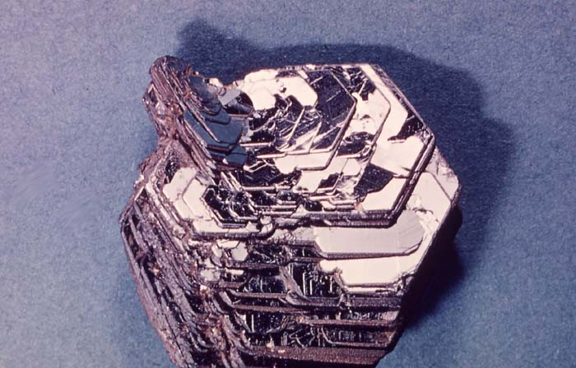
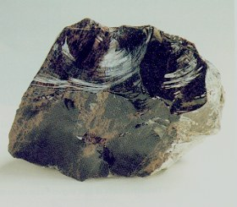
What do we know about minerals?
What is a mineral?
How are they distinct from rocks?
How can we tell them apart?
What can minerals tell us?

Slide 3
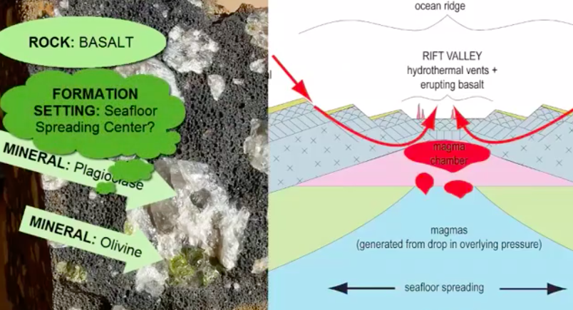
What can minerals tell us?
Minerals form under specific pressures, temperatures, and chemical conditions
Minerals in rocks can tell us about the conditions of rock formation

Slide 4
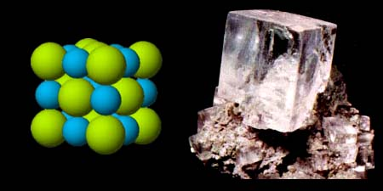
Formal Definition of a mineral;
Naturally occurring
Inorganic (Did not come from life)
Distinctive Physical Properties
In Crystalline Form
Definite Chemical Composition (Ex. NaCl)

Slide 5
Quick Quiz Which of these are minerals?
Diamond?
Salt?
Quartz?
Sugar?
Calcite?
Water?
Obsidian?
Amber?
Ice?
Coal?
Graphite?
Rubber

Slide 6
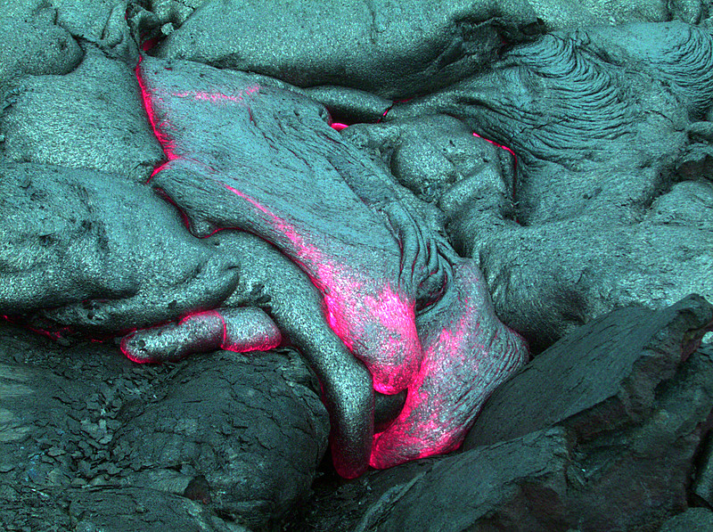
How do minerals form?
Cooling of magma (hot, liquid rock) and minerals inside the Earth (from the mantle)
Fast Cooling = No Crystals
Medium Cooling = Small Crystals
Slow Cooling = LARGE CRYSTALS

Slide 7
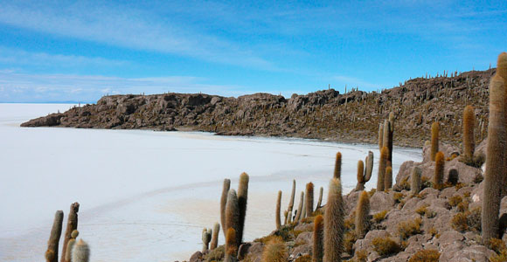
How do minerals form?
Elements dissolved in liquid (usually water)
Ex. Halite (salt) dehydrated in salt flat

Slide 8
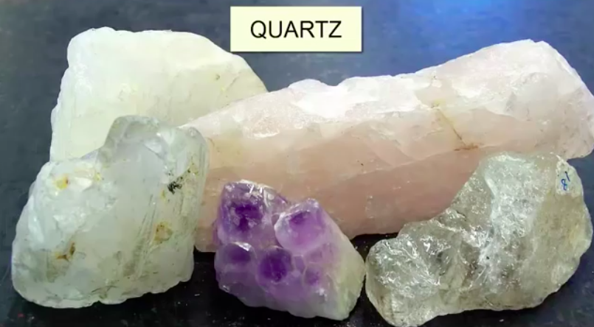
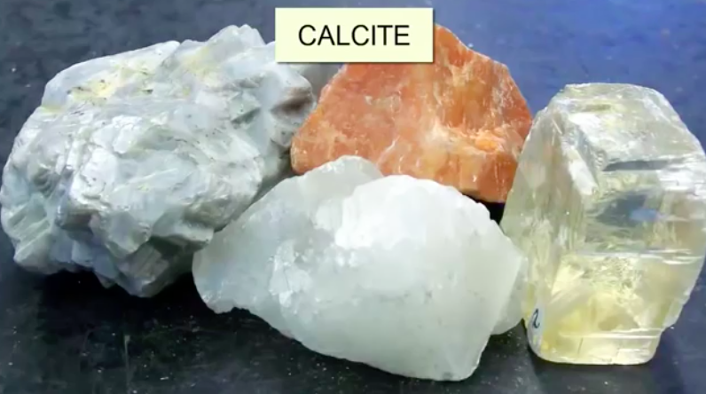
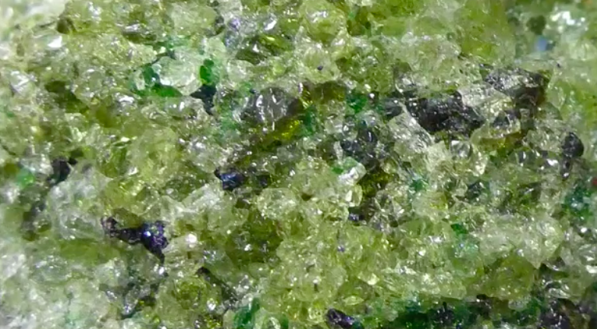
Color
Can’t always depend on color to decipher mineral
Sometimes it is a useful tool, for example: Olivine

Slide 9
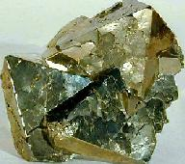
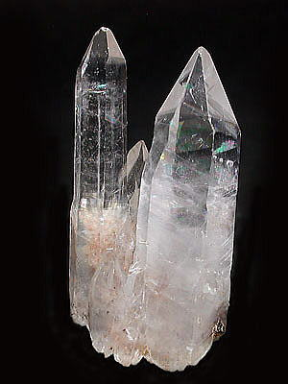
Need to use other physical properties to decipher minerals…
Luster (surface reflection)
Metallic = “shiny” like metal
Non-metallic = dull, non-shiny surface

Slide 10
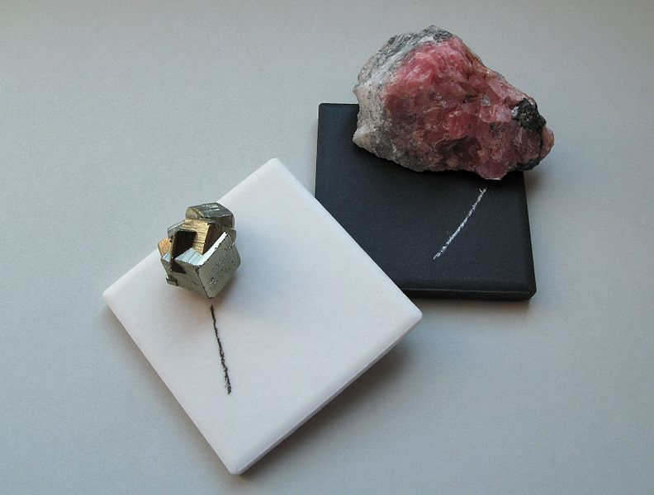
Not sure if it’s metallic?
Try testing its streak!
Color of mineral in its powdered form
A mineral’s streak will always be the same regardless of mineral color
Use the white plate for dark streaks and the black plate for light streaks
As a class: Let’s all test mineral #4
Now try mineral #5

Slide 11
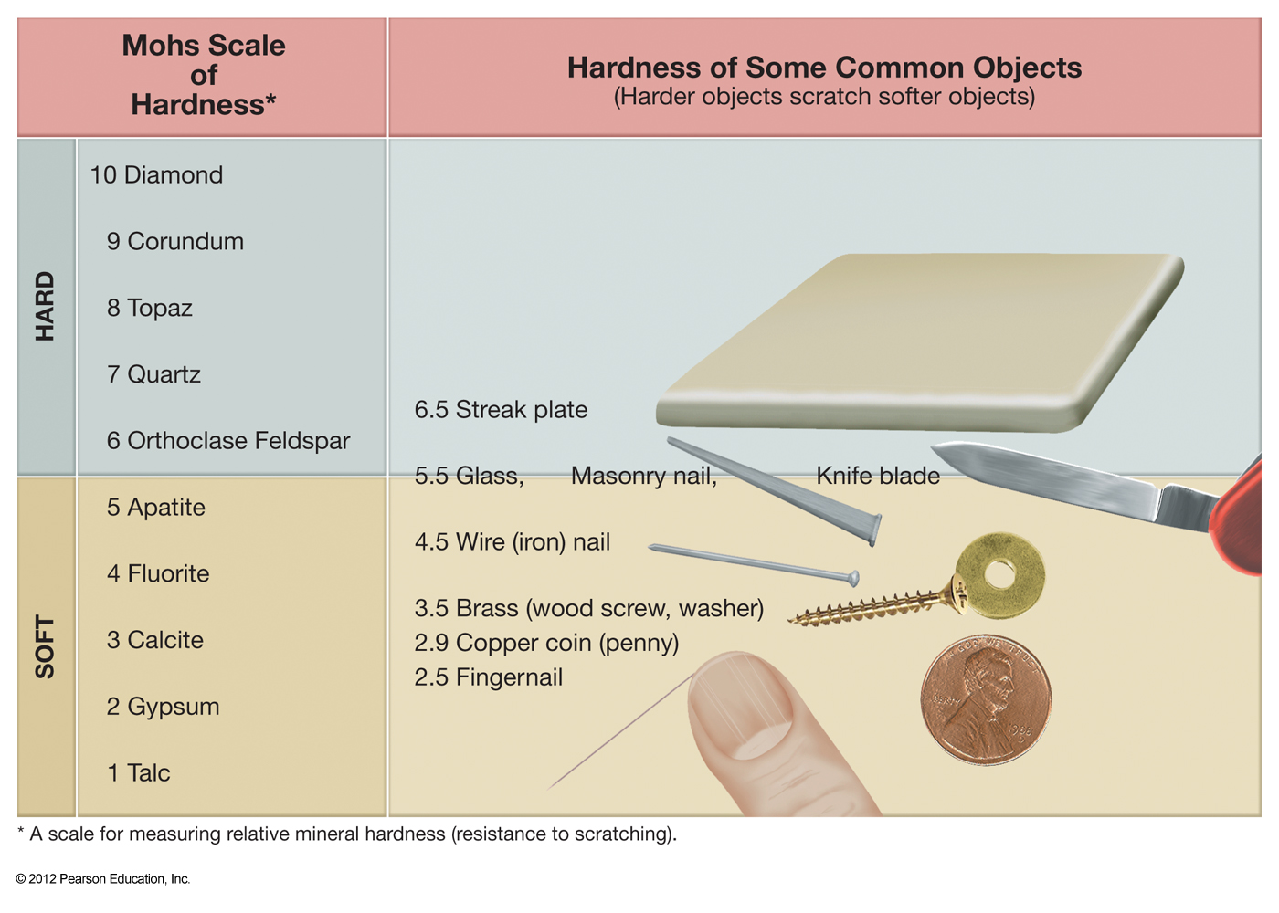
Hardness
How resistant a mineral is to being scratched
Use the tools provided to determine if a mineral is hard or soft

Slide 12
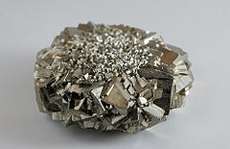
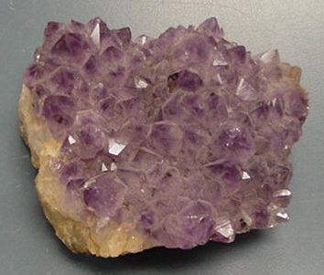
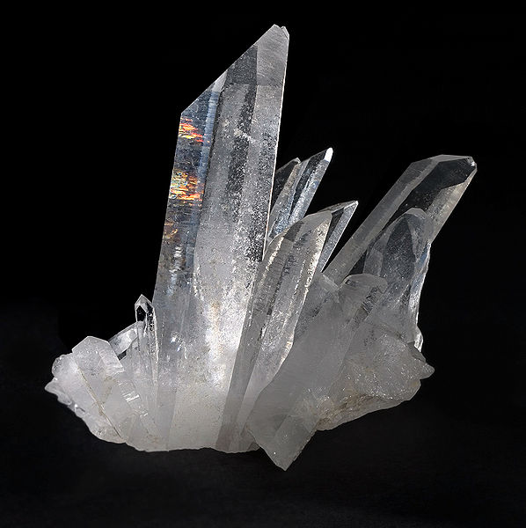
Clarity
How light travels through the mineral
Transparent; clear (you can see through it)
Translucent; foggy (some light gets through)
Opaque; no light gets through

Slide 13
Quick Quiz - Clarity
As a class; look at mineral #16
What is its clarity?
Any other defining characteristics?
As a class; look at mineral #7
What is its clarity?
Any other defining characteristics?

Slide 14
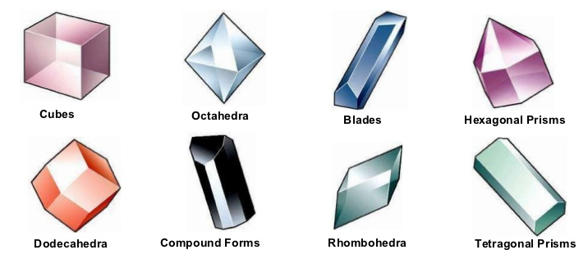
Crystal Form
How atoms and molecules in the mineral are arranged
The way crystals grow

Slide 15
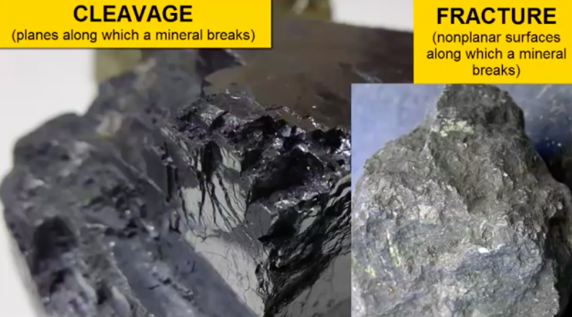
Cleavage
Tendency of some minerals to break along parallel planes in their crystal structure
- Cleavage planes: flat surfaces along which minerals break
- Fracture surface – are the curved/uneven ‘planes’ along which a mineral breaks

Slide 16
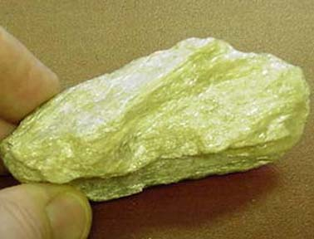
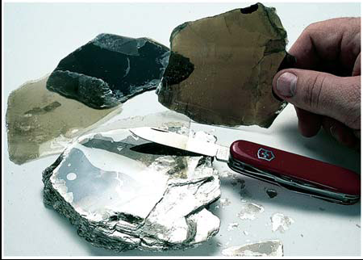
Quick Quiz - Cleavage
Find a mineral with cleavage and hold it up (remember the mineral # when you return it)
None One plane Cleavage 3 planes cleavage

Slide 17
Other Distinguishing Properties…
Specific gravity (weight)
Tenacity (elasticity)
Reaction to acid (Ex. Calcite fizzes with HCL)
Magnetism
Smell (Hint: scratch and sniff #15)
Taste (Ex. Halite with taste like salt)

Slide 18

Today’s Lab – Part I
Discuss and address the topics in the Lab Questionnaire
Discuss questions with your neighbors in class
Participate in broader class discussion
Fill out and turn in the lab questionnaire

Slide 19
Today’s Lab – Part II
We will be identifying 16 of the Earth’s core rock-forming minerals
Assemble into groups of 2, 3 or 4 people
User the Tables in the provided lab manuals
Identify the 16 minerals and fill out the mineral ID form

